Slide 1
Subscription box
Chandira Prabha S - 41611031
Aparna Kumari - 41611013

Slide 2
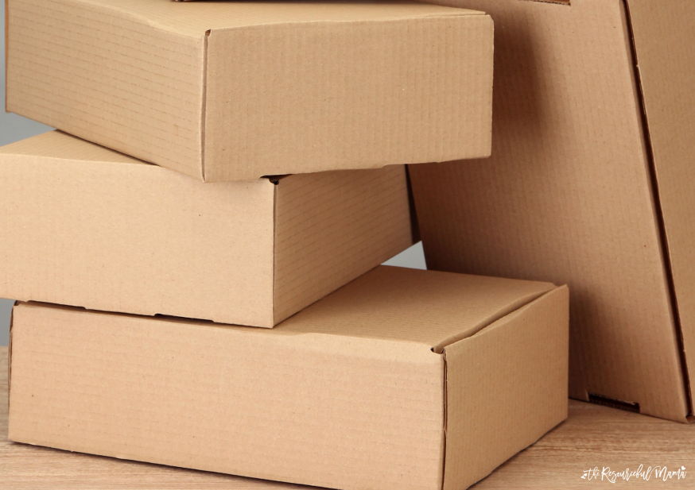
synopsis
Problem Statement
Overview of Proposed model
​Advantages
Development Process
​How it is able to generate revenue

Slide 3
PROBLEM STATEMENT
making decisions about how to design a an effective revenue gHow can a subscription box service be optimized to generate sustainable revenue and profitability over the long-term, through a combination of effective product curation, pricing strategies, marketing tactics, and operational efficiencies, while also meeting the evolving needs and preferences of customers in an increasingly competitive business-to-business landscape?
It also helps us in deciding and generation strategy that maximizes profitability while maintaining customer satisfaction, and which factors should be considered, such as pricing, shipping and handling, customer retention, and marketing, to achieve sustainable growth and success in the competitive e-commerce market?

Slide 4
Overview of proposed model
Self Care Subscription Box
A self-care subscription box is a curated collection of products and services that are designed to promote relaxation, mindfulness, and well-being. These boxes are typically delivered to subscribers on a monthly or quarterly basis, and may include a variety of items such as skincare products, wellness tools, healthy snacks, and other self-care related products.
The goal of a self-care subscription box is to provide subscribers with a convenient and affordable way to prioritize their self-care, while also introducing them to new and innovative products and services. By offering a personalized and curated experience, subscription box companies can build strong relationships with their customers and create a loyal following.

Slide 5
To create a successful self-care subscription box, companies must identify their target market and develop partnerships with high-quality brands that align with the self-care philosophy. They must also curate a selection of high-quality products that will appeal to their subscribers, and offer a personalized experience that differentiates them from competitors.
In addition, companies must offer flexible subscription models that allow subscribers to pause or cancel their subscription at any time, as well as effective marketing strategies that attract new subscribers and build brand awareness.
Overall, a self-care subscription box can be a lucrative business model for companies that are passionate about promoting wellness and helping individuals prioritize their self-care. By providing a convenient and personalized experience, subscription box companies can build strong relationships with their customers and generate recurring revenue over time.

Slide 6
Advantages
Provides convenience: A self-care subscription box provides a convenient way for individuals to prioritize their self-care without having to spend time researching and purchasing products individually. The box is delivered directly to their doorstep, saving time and effort.
Introduces new products: Subscription boxes often include new and innovative products that subscribers may not have discovered otherwise. This allows individuals to try out different products and find new favorites that they may continue to purchase in the future.
Promotes self-care: A self-care subscription box encourages individuals to prioritize their self-care by providing them with products and services that promote relaxation, mindfulness, and overall well-being.
Builds community: Subscription boxes can build a community of like-minded individuals who are interested in self-care and wellness. This can lead to a sense of belonging and connection among subscribers, which can further enhance their overall well-being.
Generates recurring revenue: Subscription boxes generate recurring revenue for companies, as subscribers typically pay on a monthly or quarterly basis. This provides a steady source of income for the company and can lead to long-term profitability.

Slide 7
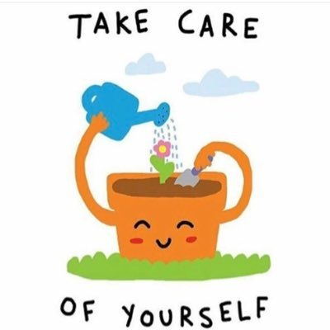
Development process
Identifying the target market
Establishing partnerships
Curating high-quality products
Creating a personalized experience
Developing a website and ordering system
Testing and refining the model
Marketing the subscription box effectively.

Slide 8


How it is able to generate revenue
The most straightforward way to generate revenue is to charge customers a subscription
fee for the monthly or quarterly delivery of curated products.
Subscription box services can also generate revenue by selling individual products or additional products outside of the subscription box. This can be done through an online store or by offering exclusive discounts to subscribers.
Subscription box services with a large subscriber base can attract advertisers and sponsors who want to reach a targeted audience. This can include sponsored products or advertisements included in the box or on the company's website or social media channels.
Subscription box services can also generate revenue through affiliate marketing by promoting other products or services that align with their brand or target market. This can be done through referral links or by partnering with other companies to offer exclusive discounts to subscribers.

Slide 9
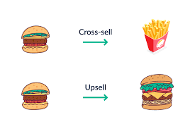
Upselling and cross-selling: Subscription box services can offer subscribers the option to upgrade their subscription to a higher tier or add additional products to their monthly box for an additional fee.
Loyalty programs: Subscription box services can offer loyalty programs that reward subscribers with exclusive discounts, early access to products, or free gifts for staying subscribed for a certain amount of time.
White labeling: Subscription box services can offer white labeling services for companies that want to create their own custom branded subscription boxes, generating revenue from the service and potential recurring orders.
Overall, there are many ways to generate revenue using a subscription box service, and the key is to be creative and offer a unique value proposition to subscribers

Slide 10
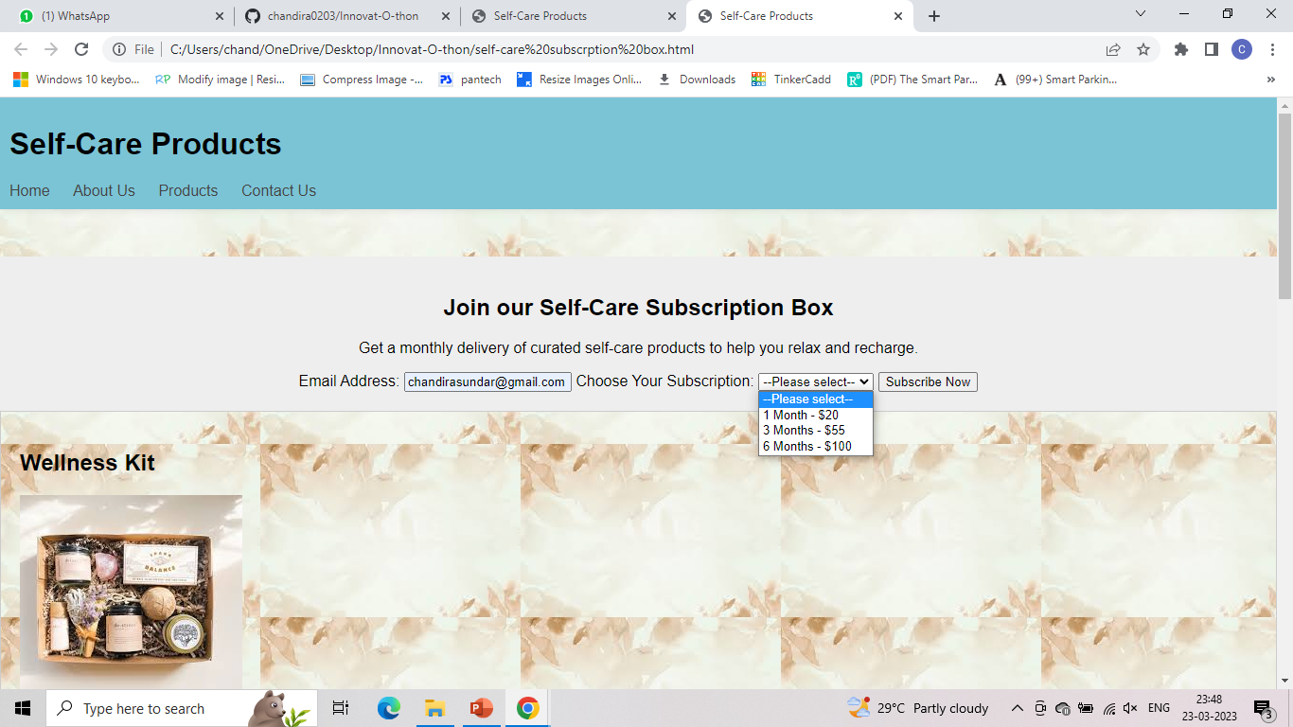

Slide 11
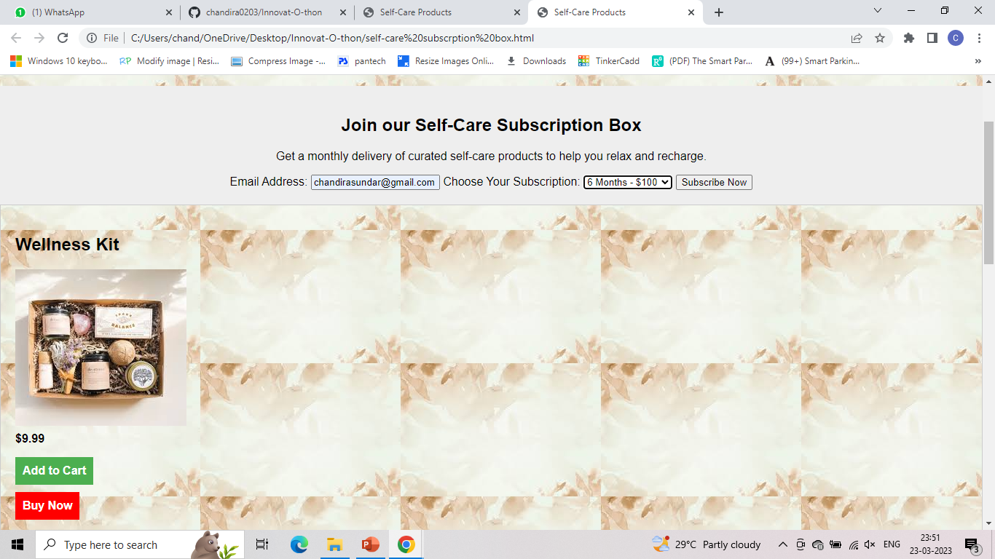

Slide 12
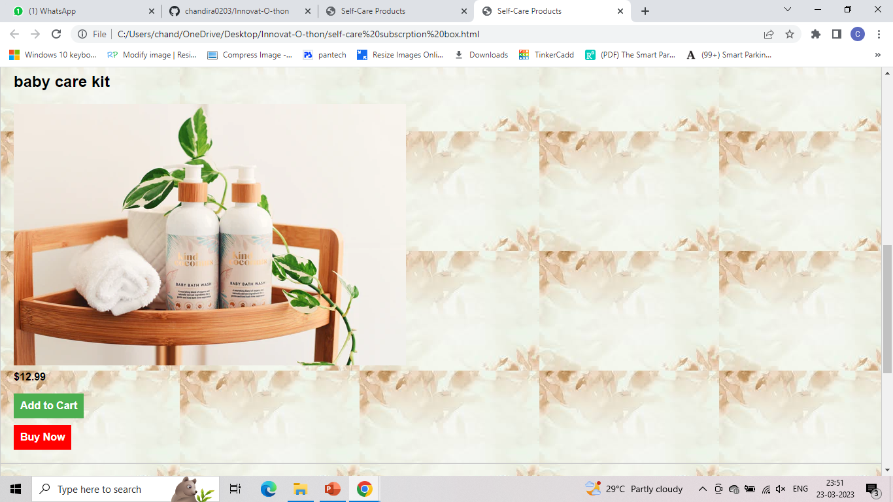

Slide 13
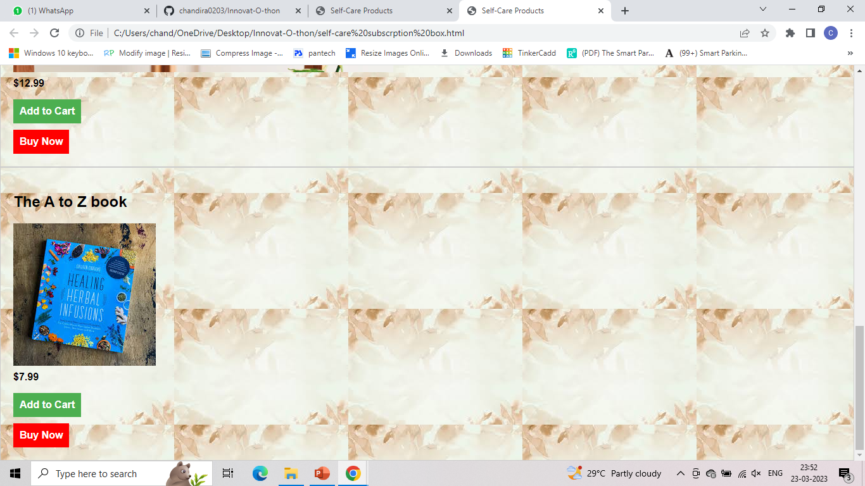

Slide 14
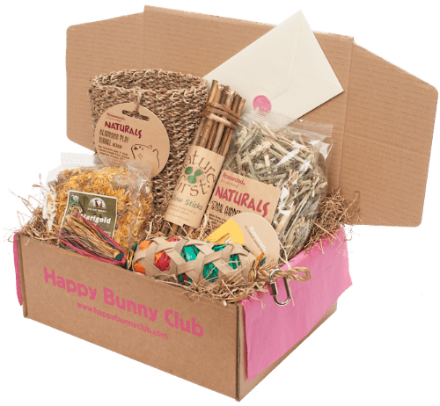
THANK YOU

